Slide 1
Stochastic Shortest Path Maze
CB.EN.P2AIE22001
ANIRUDHAN K S

Slide 2
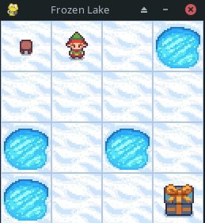
ENVIRONMENT USED
FrozenLake is a navigation problem in the Gym library.
The goal is to reach the end of the lake while avoiding falling into holes.
Action Space: Discrete(4) (LEFT, DOWN, RIGHT, UP)
Observation Space: Discrete(16)
Enabling Slipper It will move in intended direction with probability of 1/3 else will move in either perpendicular direction with equal probability of 1/3 in both directions.

Slide 3
Q learning
Q-learning is a model-free reinforcement learning algorithm
It learns the value of an action in a particular state
It does not require a model of the environment

Slide 4
Q learning
Q learning uses Q table to find the best action
Q table is updated using bellman equation
Q table consist of State X Action table
State :- all the states the agent can reach
Action:- all the the actions that an agent can take
Q table is updated by using the bellman equation

Slide 5
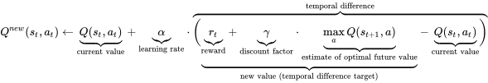
Q learning
rt i s the reward received when moving from the state St to the state St+1
maxQ(st+1,𝝰):-the maximum reward that can be obtained from state

Slide 6
Q learning
We have 15 states and 4 actions , we have a 15 X 4 Q table
All the values are initialized to zero
 | LEFT | DOWN | RIGHT | UP
0 | 0 | 0 | 0 | 0
1 | 0 | 0 | 0 | 0
….. | …… | ……. | …… | ……
….. | ….. | ….. | …… | …….
14 | 0 | 0 | 0 | 0
15 | 0 | 0 | 0 | 0

Slide 7
Q learning
Initially the agent randomly explores the maze
After 1000 iterations the angnent start to use the bellman equation to update Q table
The updated Q table after 100000 iterations
 | LEFT | DOWN | RIGHT | UP
0 | 1.59e-04 | 5.41e-04 | 2.35e-04 | 1.82e-04
1 | 5.21e-04 | 6.16e-04 | 1.48e-03 | 4.12e-04
….. | …… | ……. | …… | ……
….. | ….. | ….. | …… | …….
14 | 7.29e-03 | 1.65e-01 | 3.58e-01 | 1.83e-01
15 | 0 | 0 | 0 | 0

Slide 8
Q learning
After updating the Q table the agent uses it to find the path to goal
It choose the best action at each state from the Q table

Slide 9
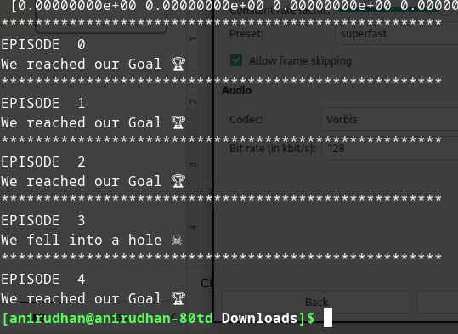
Result
By running 5 episodes the agent fails once and successfully win’s 4 times

Slide 10
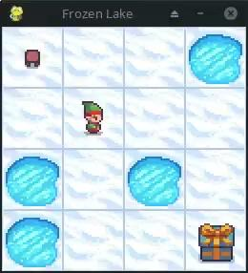
Result

Slide 11
Reference
https://en.wikipedia.org/wiki/Q-learning
https://ojs.aaai.org/index.php/AAAI/article/view/11170
https://www.youtube.com/watch?v=9g32v7bK3Co
https://www.youtube.com/watch?v=HpaHTfY52RQ

